Slide 1

Daily NASA Dashboard
By: -
Parth Parashar
Vivian Huynh

Slide 2
Application
This application is a dashboard where interesting data and photos about astronomical objects such as Planets, Sun , Asteroids etc are accumulated.
A bunch of the information displayed on this Dashboard is fetched using NASA’s free bundled APIs
We chose to build this application because it would be interesting to see all the information about Astronomical objects clubbed in the same area along with a bunch of live information about these objects being transmitted by the NASA open-source bundled APIs

Slide 3
Features
Astronomy picture of the day
Live Mars Rover Feed
Near Object Sightings
Pages for different planets with further information
Photos of Astronomical Objects
Information about Meteors
Information about Asteroids
Information about Galaxies
Information about Sun

Slide 4
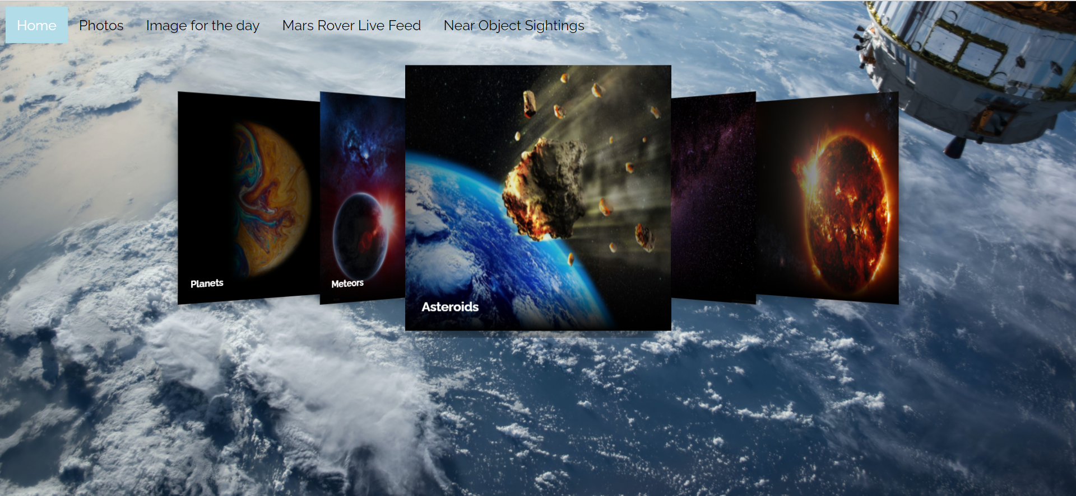
Dashboard Depicting Features

Slide 5
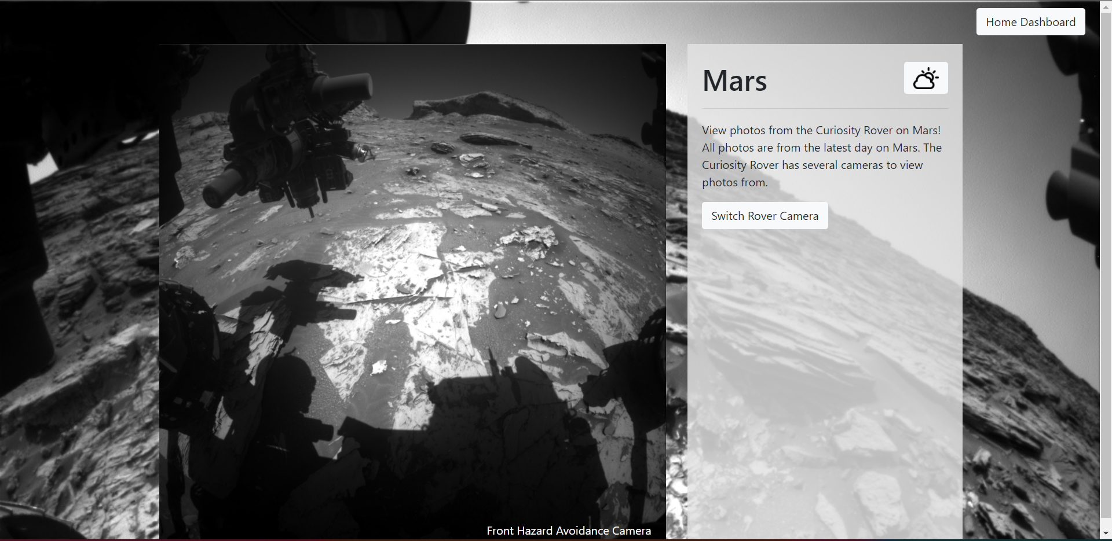
Mars Rover Live feed

Slide 6
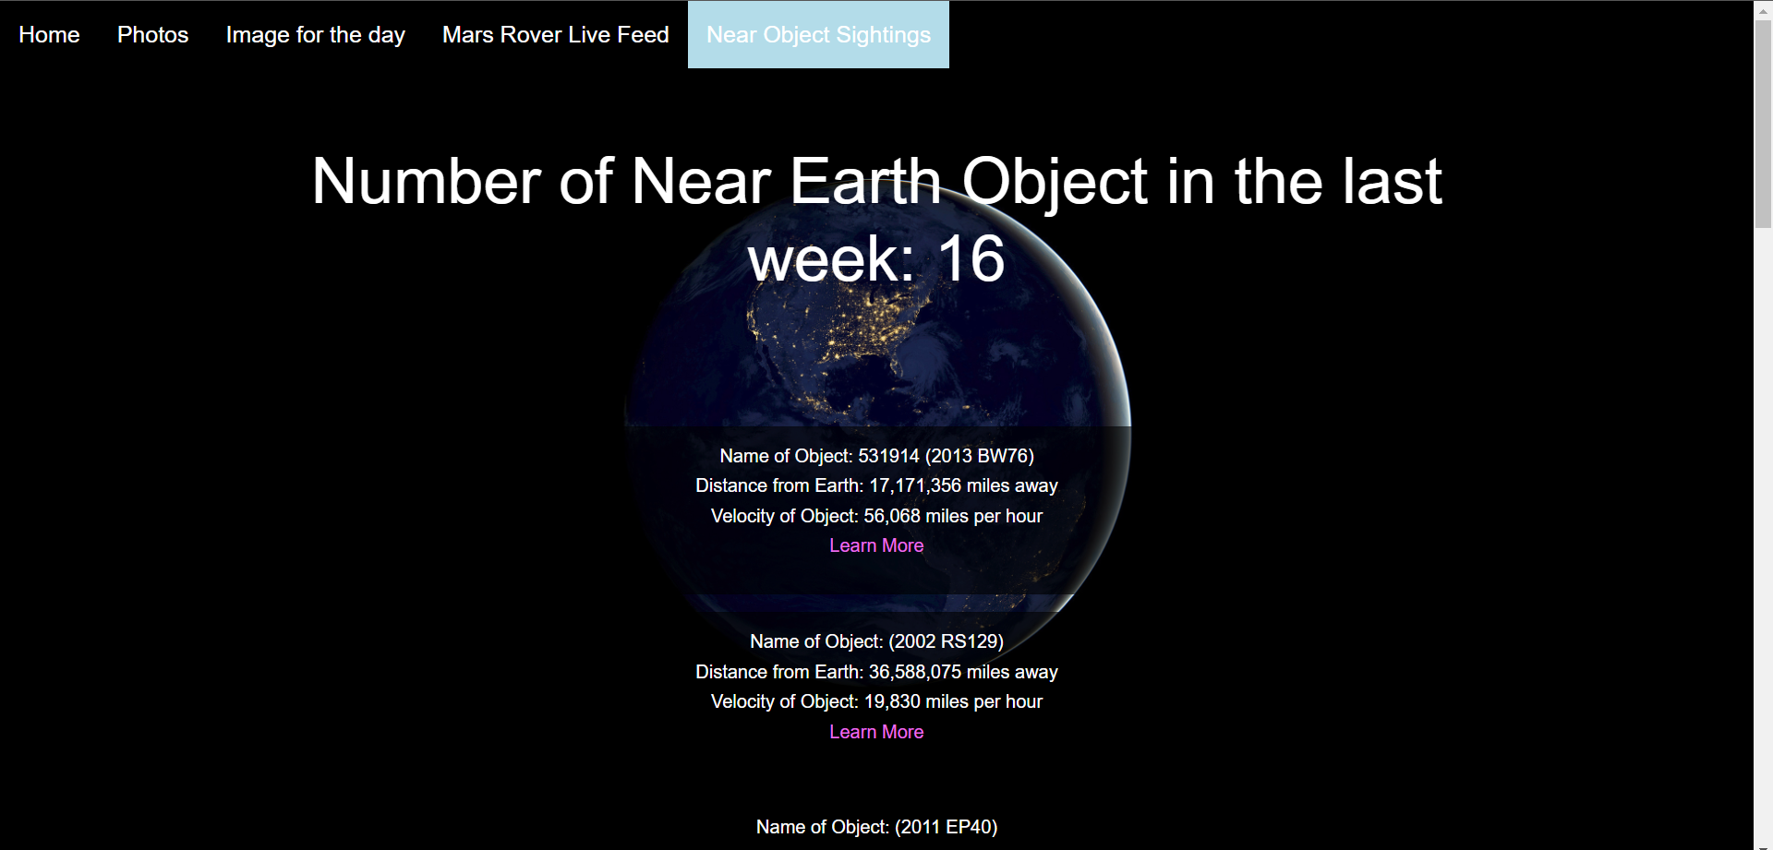
Near Object Sightings

Slide 7
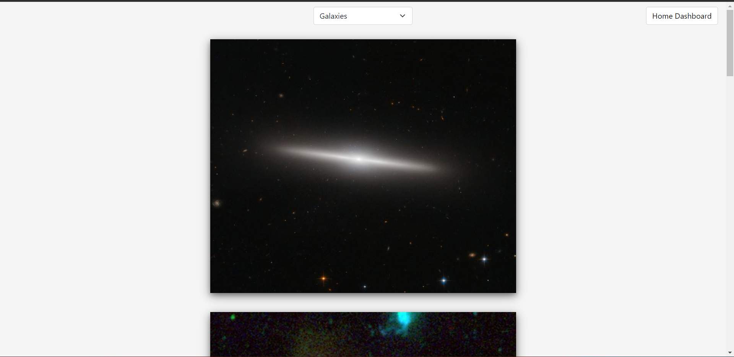
Photos

Slide 8
Technology Stack Used
HTML
CSS
Javascript
React Libraries
Ajax

Slide 9
Problems Faced
Problem with the Navbar settings with the slider
We faced the problem of navbar being in line with the slider. We used slider for the home page and planets page and this particular slider required the page to have div containers which were really hard to adjust to proper settings.
So to overcome this problem, we decided on dividing the div elements in the form of a single element and then using the nth child property in CSS to expand and collapse on the dashboard so that it maintains the required results
Also, With the slider, we wanted to have the effect of click and expand to the slides. To incorporate this feature using HTML and CSS only, we needed to work on Transform and Translate property of CSS along with transition delay and background change for all the elements.
This is why we needed to divide it in various smaller divs to have the control over the behaviour

Slide 10
Problems Faced
Problem with the NASA APOD API
The NASA APOD API works well for most of the part by sending HD images as responses for the request. But there are instances where the API is slow to load or hangs
Also, there are some days (once or twice a year) when the API sends video/ Video links instead of images that it generally sends.
These are youtube links and need the youtube API to be called.
The last time this happened was on 30th November 2021 after 28th December 2018
To address this issue, we have to inculcate the youtube linking API which was not possible as it is extensive and would have required us for purchasing the key.

Slide 11
Problems Faced
Problem with the NASA Image and Video Library API
Original idea was to allow the user to search for any photos from NASA
Wasn’t able to fetch API response through JavaScript, but was able to with Postman
Tried fetch, XMLHttpRequests, etc.
Decided to grab API response through Postman and use the image urls returned to create a static Photos page instead with pre-selected topics to view

Slide 12
Future Scope
This Dashboard can further be expanded to include other interesting NASA APIs and their results such as the ISS tracker.
This will lead to a wholesome experience of Astronomy and can serve as a one stop dashboard for all things related to astronomical objects.
Photos page could be expanded to allow a search for any NASA photos.
Image for the day page could be improved to have videos displayed as well.
The responsiveness/accessibility could be improved.

Slide 13
Demo
https://vivianh1234.github.io/NASA-Dashboard/

Slide 14
Questions?

